Slide 1
Building a Lightning Component with Angular Material Design
Patricia Cifra
Senior Software Engineer
pncifra@spanning.com
@pncifra

Slide 2
Overview
Lightning Component
What is a Lightning Component
Basics of creating a Lightning Component
Anatomy of a Lightning Component
Tools
Material Design
What is Material Design?
Where is it used?
Sample patterns
Using it in a Lightning App/Component

Slide 3
What is Lightning?
Component Framework
Set of tools for developers and business analysts
Build Apps
Integrate Data
Automate Business Processes

Slide 4
Overview of Lightning Tools
Lightning Connect: access data from external sources
Lightning Component: UI framework for developing web apps for mobile or desktop devices
Lightning App Builder: build apps without coding
Lightning Process Builder: workflow tool

Slide 5
Setting Up Lightning
Enable Lightning for your Org.
Click Develop → Lightning Components and select “Enable Lightning Components” and “Enable Debug Mode”
Option 1: Create a new Lightning Component via Sublime plugin
Option 2: Create a new component from Developer Console in Salesforce
View Lightning Components
Click Develop → Lightning Components

Slide 6
Lightning Files
Component or Application
File contains the declarative markup for the component or app
Controller
Contains the JavaScript controller methods to handle events fired and components
CSS
CSS styles scoped to the component
Helper
Contains JavaScript methods that can be called from anywhere in the component’s bundle. (very helpful!)

Slide 7
Third Party Dependencies
Lightning Components do not allow you to load JavaScript libraries from a source outside of your Salesforce domain.
Upload your resources as a static resource
Perform this in the setup view of the Salesforce organization
Create a zip archive of those resources
Create a package in your organization
Verify you can access your resource file

Slide 8
Loading Dependencies - RequireJS
Resource isn’t loaded by the time the application renders
New release Spring 15: <ltng: require /> tag allows you to load scripts.
RequireJS to load dependencies for Lightning Components
Add a Lightning Component dependency to your component that will load RequireJS then fire a Lightning event that will trigger a controller function in your code that calls a helper function where you specify third party dependencies

Slide 9
Lightning/Aura Attributes
aura:id – The id tag enables you to assign a unique id to elements in your Lightning component.
aura:attribute – The attribute tag is how you can define Salesforce data to be stored for a component. It has been very useful to use the Lightning infrastructure to call an apex controller that will populate an aura attribute. Then firing a Lightning event enables you to continue processing the data in your application with the third party library handlers.
aura:handler – This tag wires a handler function in your Lightning controller to Lightning events.

Slide 10
Material Design
Environment
3D World: material environment is 3D Space
All Objects have x,y, z dimensions
Light and Shadow
Shadows cast by two light sources, indicate height, space and positioning
Material Properties
Physical properties
Transforming properties
Elevation and Shadows
Shadows and Object relationships

Slide 11
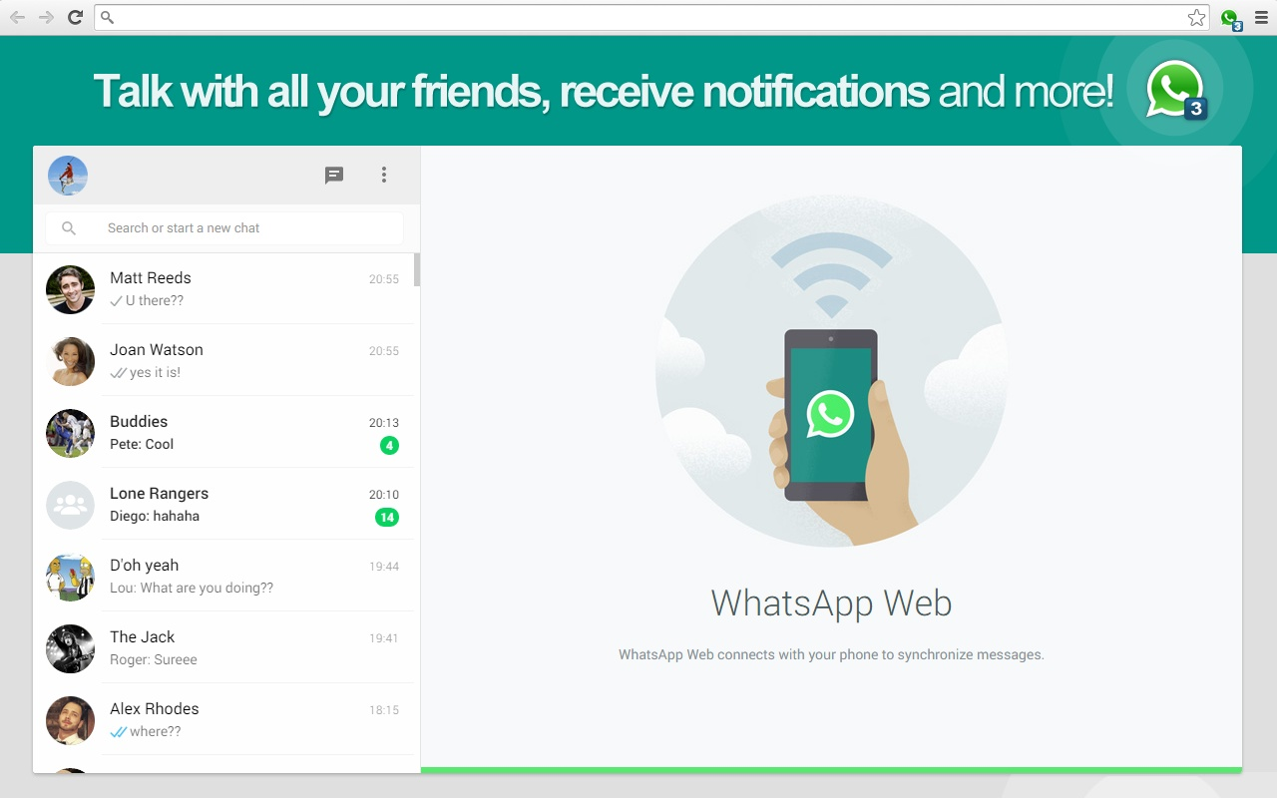
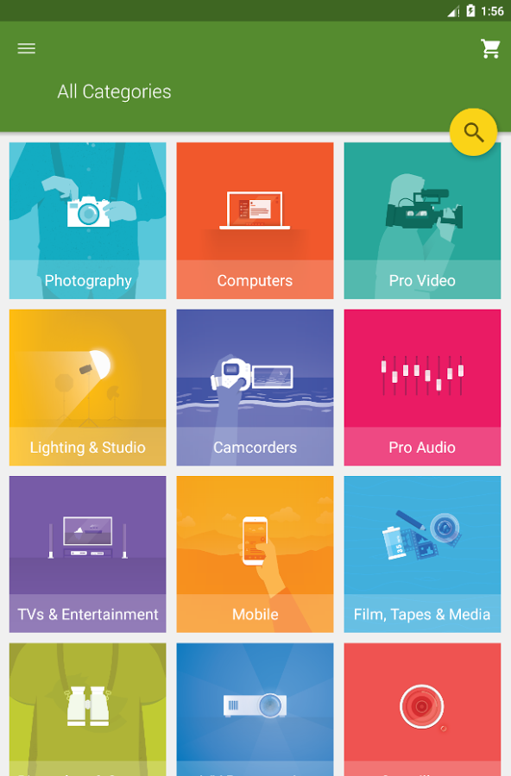
Material Design in the Wild

Slide 12

Material Design
Depth – Placement and positioning

Slide 13

Material Design
Depth – Use shadows

Slide 14
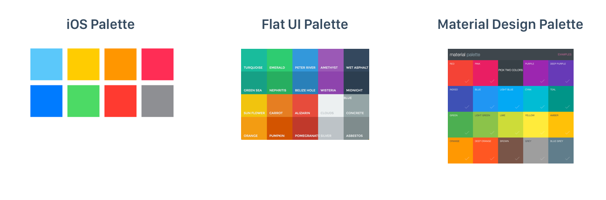
Material Design
Color Palette

Slide 15
Putting it all together – ToDo List App Example
Create custom ToDo Objects
Create Apex class to access custom objects
Create Lightning event to notify when custom objects have been loaded
Create and load static resources
Create Lightning App
Controller
Helper
CSS
Component

Slide 16
Developer Tools
Sublime Lightning Plugin
https://github.com/dcarroll/sublime-lightning
Package Control for Sublime
https://packagecontrol.io/installation
ForceCli: work with force.com data from command line
https://force-cli.herokuapp.com/
Fix MacPath plugin: Fixes path settings for Sublime
In Package Control: Install Plugin: search for “FixMacPath”

Slide 17
Recap
Lightning Apps/Components
Controller – JavaScript controller methods
Component – Declarative markup
Helper – JavaScript methods available throughout component bundle
Events - App or component level events that you can register and attach handlers for, pass parameters.
Material Design
https://www.google.com/design/spec/material-design/introduction.html
https://material.angularjs.org/latest/#/

Slide 19



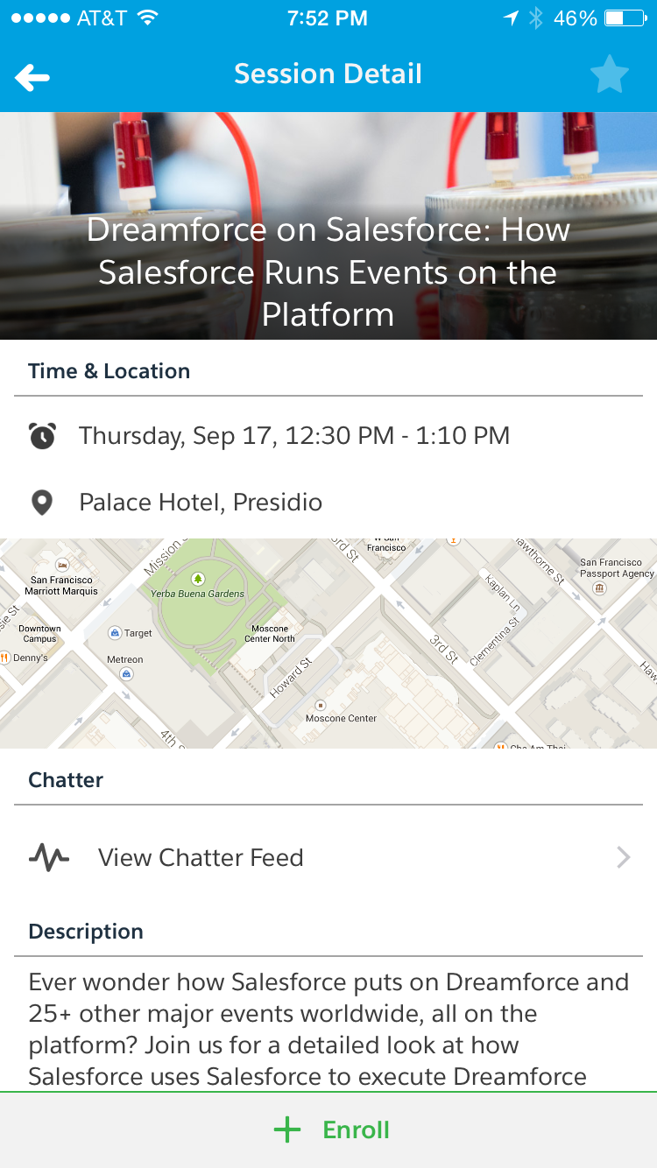
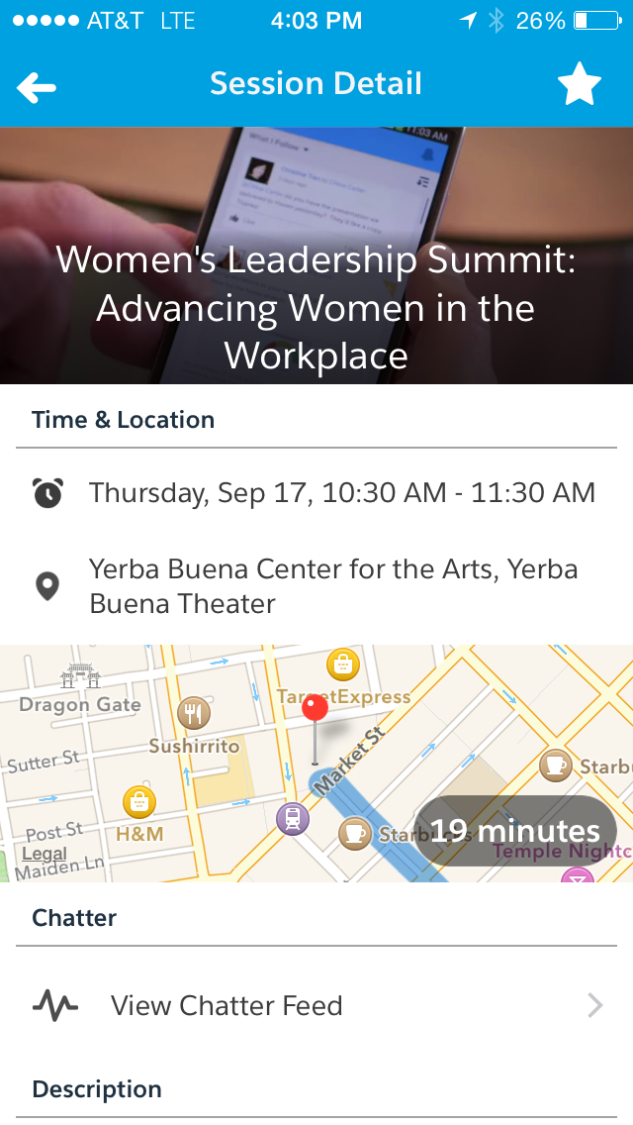

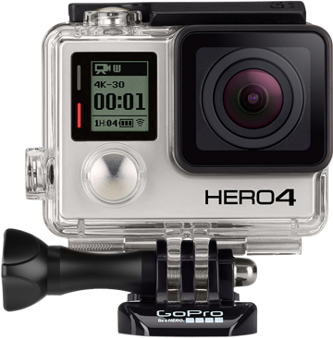

Share Your Feedback, and Win a GoPro!
Earn a GoPro prize entry for each completed survey
Tap the bell to take a survey
1
Enroll in a session
2
3

